Slide 1
Optimal Cooking
Group 2: Mahin Ali, Harry Cole, Yasmin Khandakar-Uddin,
Akif Mohammed Mohit, Yi Tan, Samuel Walker

Slide 2
Introducing the task
Research into cooking processes
Modelling methods
Results Conclusion
1
2
3
4
5
Optimal Cooking

Slide 3
Introducing the task
1
Here we will talk about the task we were set and the direction we had gone about to best provide a solution

Slide 4
Introducing the task
Project Brief: Our project goal was to create a piece of software that would be able to calculate how long it would take to cook different types of food with a variety of shapes and produce a visual aid to help understand how the heat distributes through the food.

Slide 5
Introducing the task
Identified 4 key project areas:
Background research into cooking.
Investigating the evolution of temperature in food products.
Creating models for a variety of shapes and cooking processes.
Solving for the distribution of the temperature in the food as time progresses.

Slide 6
Research into cooking processes
2
Here we will talk about what information we had found out after researching into cooking food

Slide 7
Research into cooking processes
Types of cooking
Conventional Ovens: heating elements at the top and bottom of the oven.​
Convection Ovens: heat inside the oven is considered equal all throughout air.​
Boiling: submerging the food in boiling water, temperature around food is equal.​

Slide 8
Research into cooking processes
Safe cooking temperatures
Temperature-Time combinations to ensure food is heated correctly to kill bacteria:​
60°C for 45 minutes​
65°C for 10 minutes ​
70°C for 2 minutes​
75°C for 30 seconds​
80°C for 6 seconds​
Main food we explored is Pizza and it should be cooked to 74 C.

Slide 9
Modelling methods
3
Here we will talk about what we had procedures we had taken to help produce a model that produces results.

Slide 10
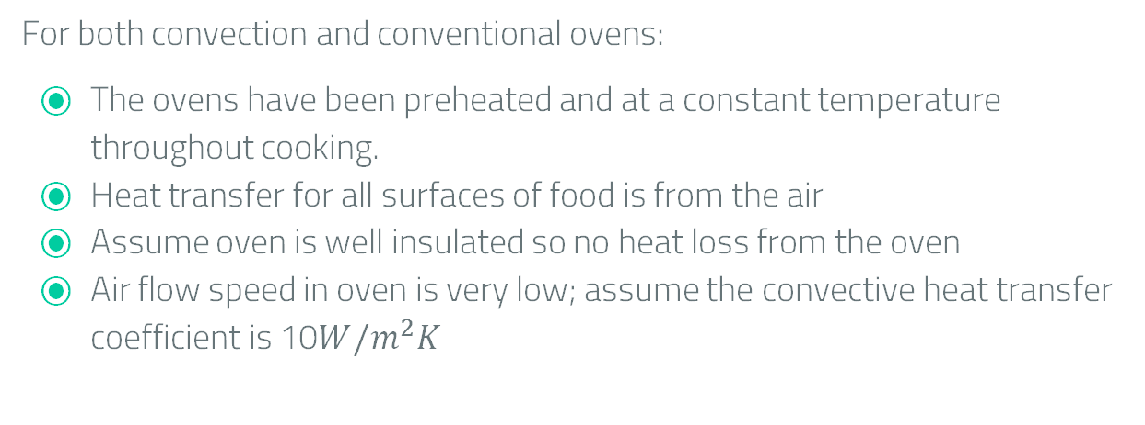
Modelling methods
Assumptions for oven cooking
For both convection and conventional ovens:​
The ovens have been preheated and at a constant temperature throughout cooking.​
Heat transfer for all surfaces of food is from the air​
Assume oven is well insulated so no heat loss from the oven
Air flow speed in oven is very low; assume the convective heat transfer coefficient is 10$W/m^{2}K$

Slide 11
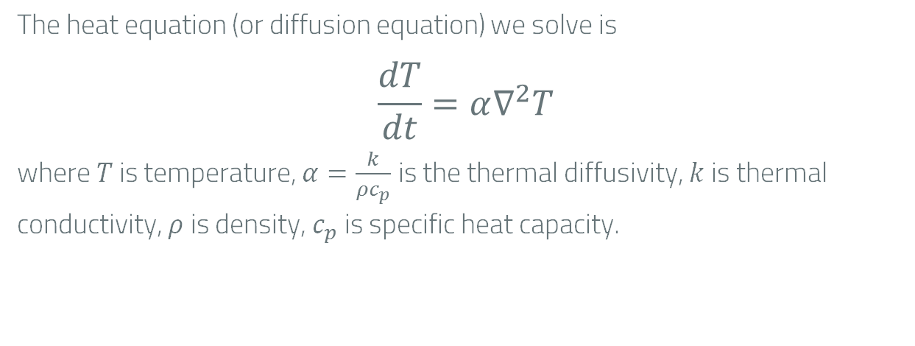
Modelling methods
Heat Equation
The heat equation (or diffusion equation) we solve is
$$\frac{dT}{dt}=α∇^{2}T$$
where $T$ is temperature, $α=\frac{k}{ρc_{p}}$ is the thermal diffusivity, $k$ is thermal conductivity, $ρ$ is density, $c_{p}$is specific heat capacity.
Notes:
Talk about what each variable mean in the heat diffusion eq

Slide 12
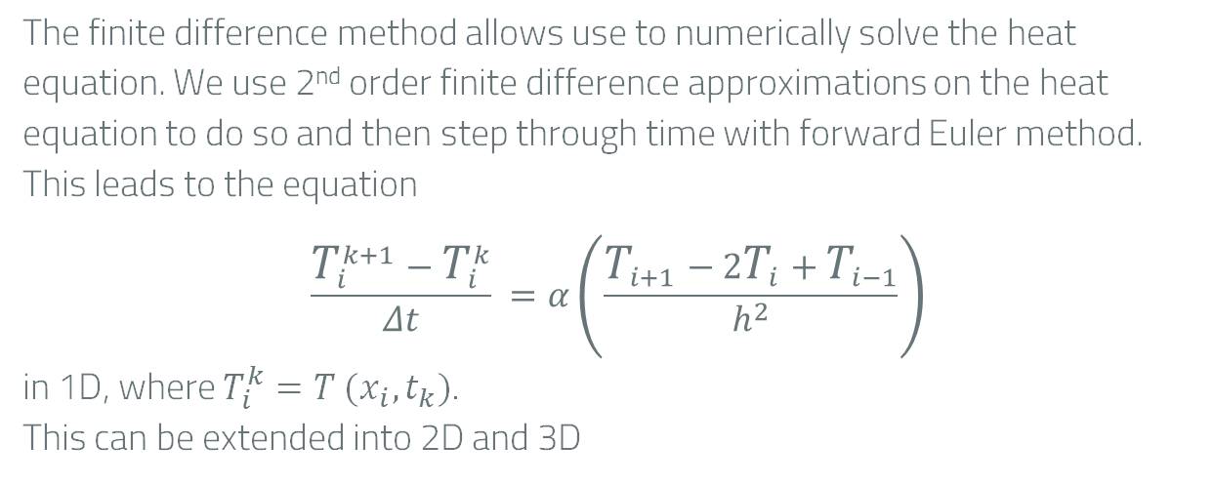
Modelling methods
Finite Difference Method
The finite difference method allows use to numerically solve the heat equation. We use 2nd order finite difference approximations on the heat equation to do so and then step through time with forward Euler method.
This leads to the equation
$$\frac{T_{i}^{k+1}−T_{i}^{k}}{Δt} =α\left(\frac{T_{i+1}−2T_{i}+T_{i−1}}{h^{2}}\right)$$
in 1D, where $T_{i}^{k}=T (x_{i},t_{k})$.
This can be extended into 2D and 3D
Notes:
Talk about what each variable mean in the heat diffusion eq

Slide 13
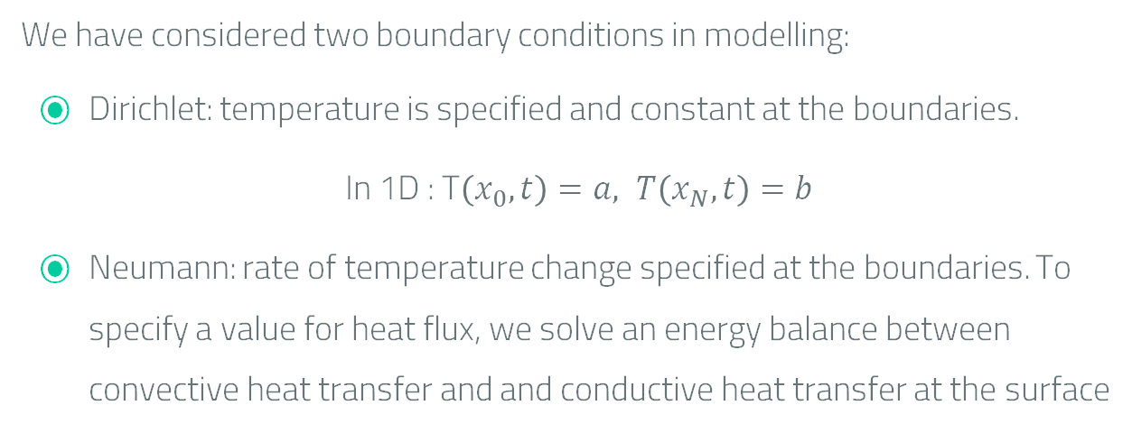
Modelling methods
Heat Equation Boundary Conditions
We have considered two boundary conditions in modelling:
Dirichlet: temperature is specified and constant at the boundaries.
In 1D : T$\left(x_{0},t\right)=a, T\left(x_{N},t\right)=b$
Neumann: rate of temperature change specified at the boundaries. To specify a value for heat flux, we solve an energy balance between convective heat transfer and and conductive heat transfer at the surface
Notes:
Say what Lx,Ly mean

Slide 14
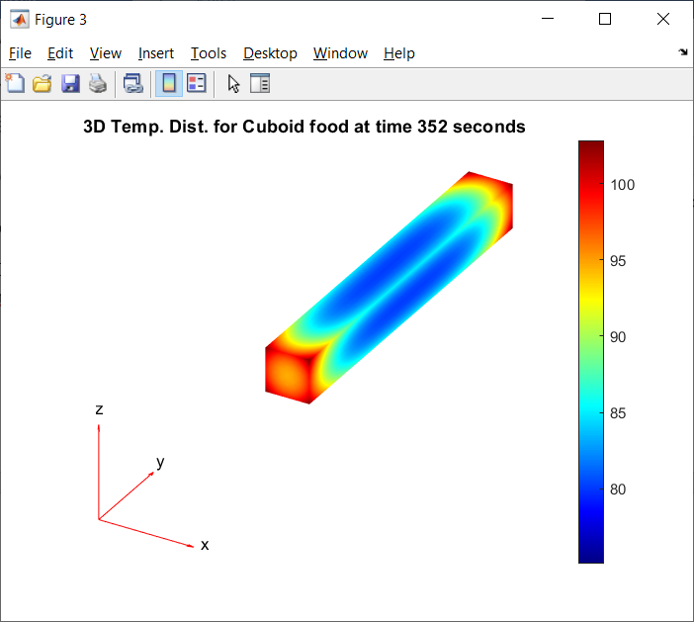
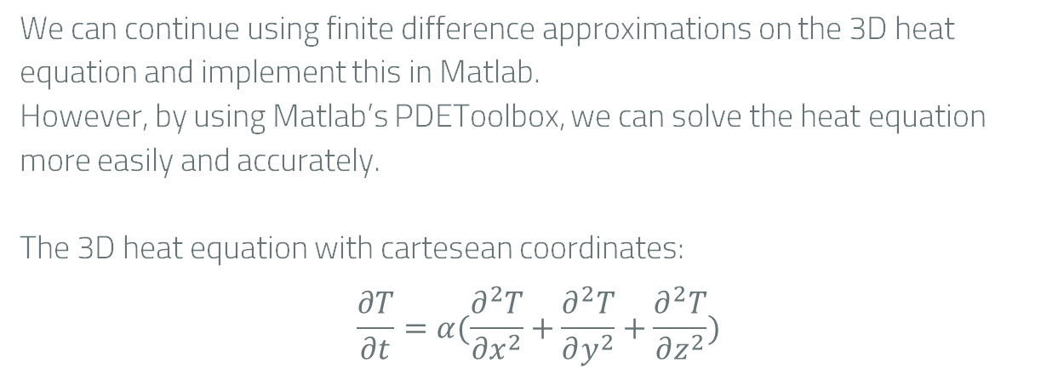
Modelling methods
Modelling with Matlab PDEToolbox
We can continue using finite difference approximations on the 3D heat equation and implement this in Matlab.
However, by using Matlab’s PDEToolbox, we can solve the heat equation more easily and accurately.
The 3D heat equation with cartesean coordinates:
$$\frac{∂T}{∂t}=α(\frac{∂^{2}T}{∂x^{2}}+\frac{∂^{2}T}{∂y^{2}}+\frac{∂^{2}T}{∂z^{2}})$$

Slide 15
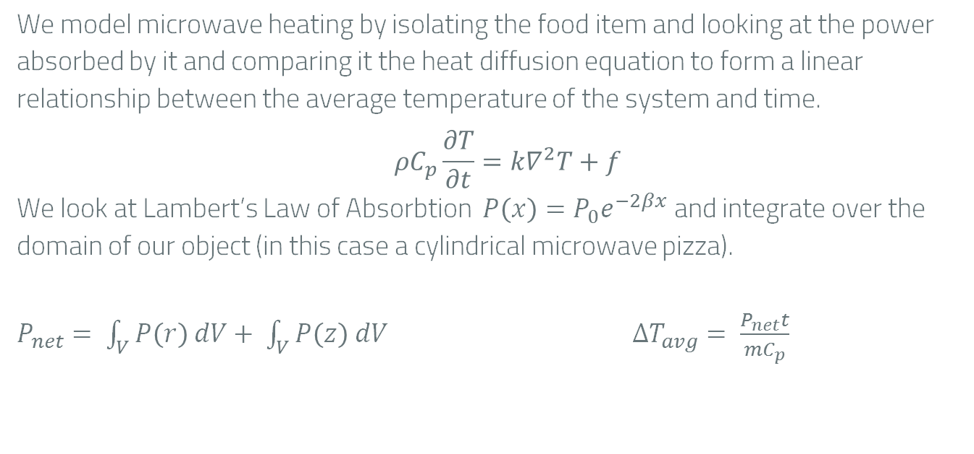
Modelling methods
Microwave maths
We model microwave heating by isolating the food item and looking at the power absorbed by it and comparing it the heat diffusion equation to form a linear relationship between the average temperature of the system and time.
$$ρC_{p}\frac{∂T}{∂t}=k∇^{2}T+f$$
We look at Lambert’s Law of Absorbtion $P\left(x\right)=P_{0}e^{−2βx}$ and integrate over the domain of our object (in this case a cylindrical microwave pizza).
$P_{net}= \int_{V}^{ }{P\left(r\right) dV}+ \int_{V}^{ }{P\left(z\right) dV}$ $∆T_{avg}= \frac{P_{net}t}{mC_{p}}$

Slide 16
Modelling methods
Modelling cases
Cooking pizza in an oven with Dirichlet conditions.
Cooking pizza in an oven with Neumann conditions.
A Chip in an oven with Neumann conditions.
Braising a cylindrical roll of meat.
Boiling a potato.
Microwaving a pizza

Slide 17
How Long Do You Think our Model Will Take to Cook a 3 Minute Microwave Pizza?
Less than 1 Planck time (5.39 x 10⁻⁴⁴)
A few seconds
Close to 3 minutes
About half an hour
Close to a year
Close to the age of the universe (14 x 10⁹ years)

Slide 18
Results
4
Here we will talk about what we results our models had generated.

Slide 19

Results
Cooking a pizza
PDE Heat equation in 1D:
Looking for the time taken for a pizza of height 1cm to be at least 75°C at the central point and obtain a temperature gradient throughout the pizza.
Condition for both pizza models:
Initial temperature of pizza is -18°C
Finished when pizza has reached 75°C
Temperature of oven at start is 200°C uniform

Slide 20
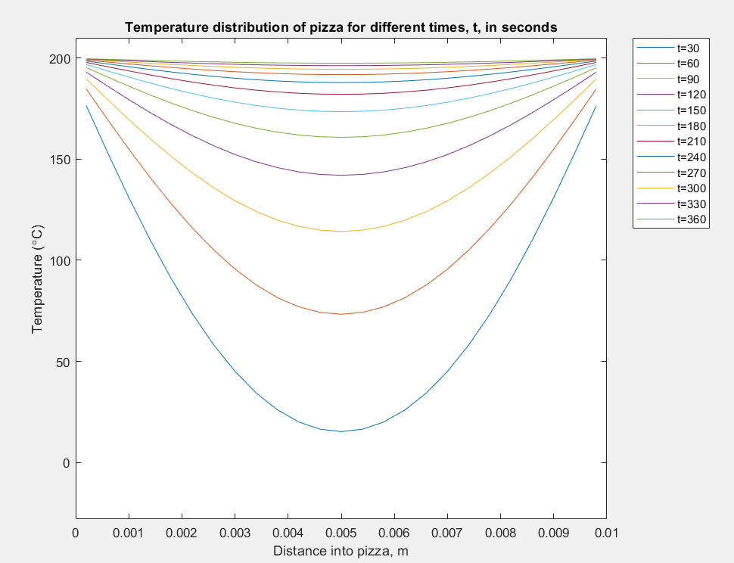
Results
Cooking a pizza Dirichlet
Initial uniform temperature of – 18°C;
Surface of the pizza is at the oven's temperature, 200°C, at time t=0;
We find that for the pizza to reach a minimum temperature of 75°C it takes 61.1 seconds
Model does not represent real life cooking times for an oven
More accurately describes cooking pizza in an Italian brick oven

Slide 21
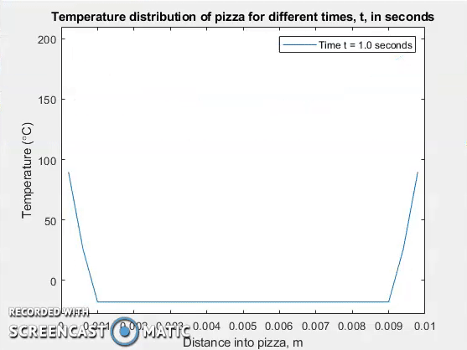

Slide 22
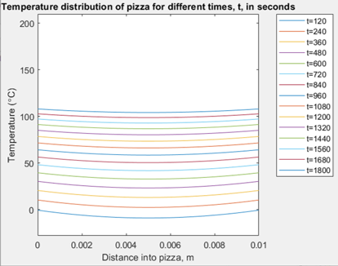


Results
Cooking a pizza Neumann
At x=0 surface
At x=L surface
Temperature distribution at t=0 is uniform
At around 20 minutes the center of the pizza has reached 75°C which is how long it'd take in real life as well, which is an improvement from the last model.
Notes:
Talk about why them conditions, i.e. prevents food temp from exceeding air temp as heat flux = 0 as approach

Slide 23
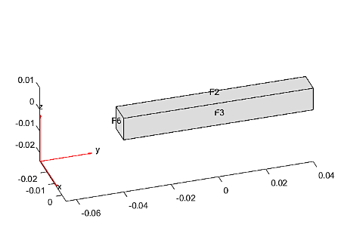
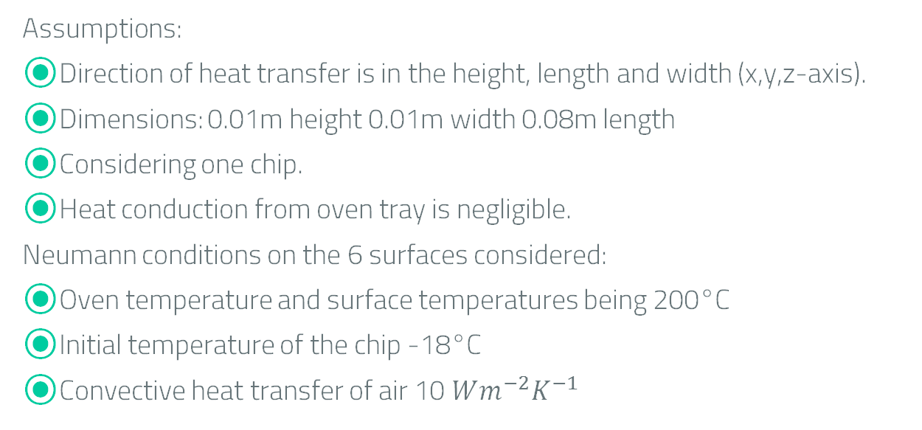
Results
Cooking a chip 3D
Assumptions:
Direction of heat transfer is in the height, length and width (x,y,z-axis).
Dimensions: 0.01m height 0.01m width 0.08m length
Considering one chip.
Heat conduction from oven tray is negligible.
Neumann conditions on the 6 surfaces considered:
Oven temperature and surface temperatures being 200°C
Initial temperature of the chip -18°C
Convective heat transfer of air 10 $Wm^{−2}K^{−1}$
Notes:
Considering one chip as multiple wouldn’t significantly affect the outcome of an individual chip.

Slide 24
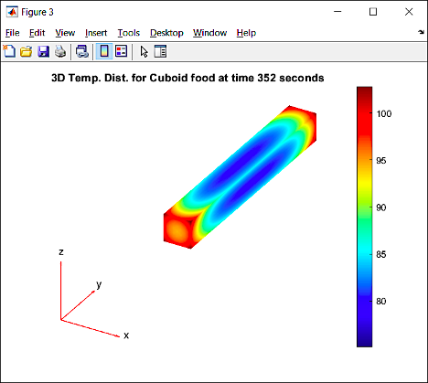
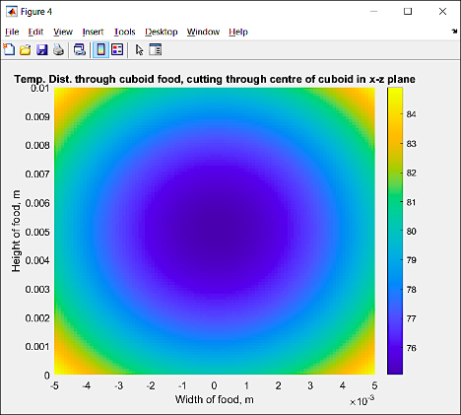
Results
Cooking a chip 3D
We say the chip is cooked when it all reaches at least 75°C which occurred at 352 seconds.
The corners of the chip appear to heat up faster which we couldn’t visualize in 1D, this explains the crispy edges we often see in real life.
Notes:
Talk about how faster time may be due to singular chip, not blocked from the heat unlike other chips.

Slide 25
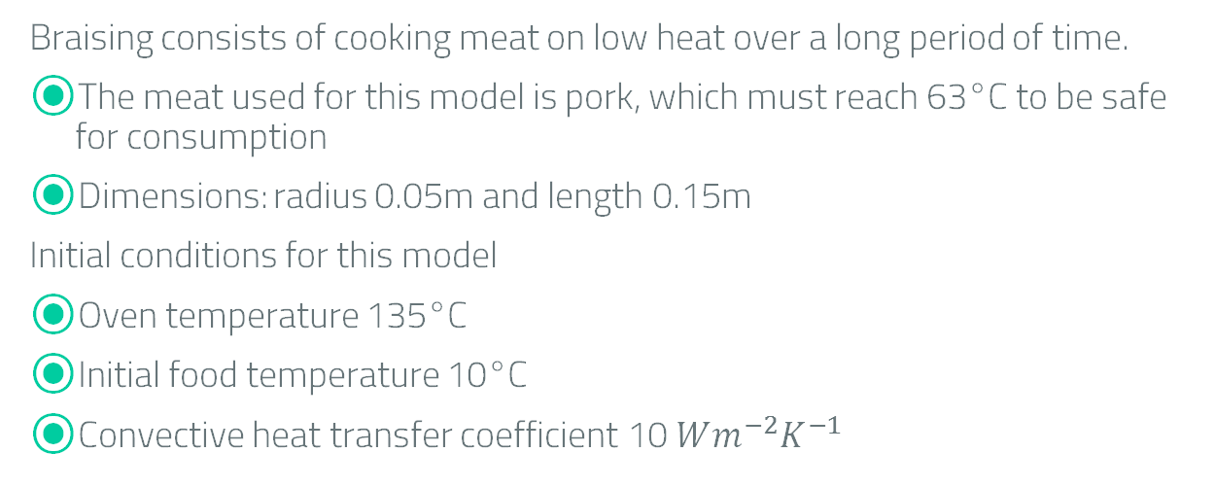
Results
Braising a cylindrical roll of meat
Braising consists of cooking meat on low heat over a long period of time.
The meat used for this model is pork, which must reach 63°C to be safe for consumption
Dimensions: radius 0.05m and length 0.15m
Initial conditions for this model
Oven temperature 135°C
Initial food temperature 10°C
Convective heat transfer coefficient 10 $Wm^{−2}K^{−1}$

Slide 26
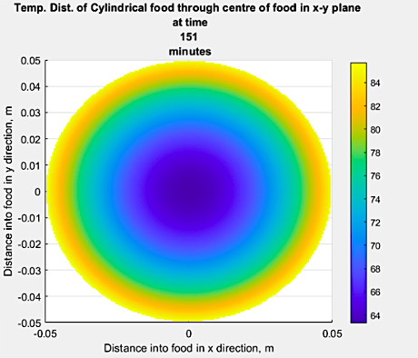
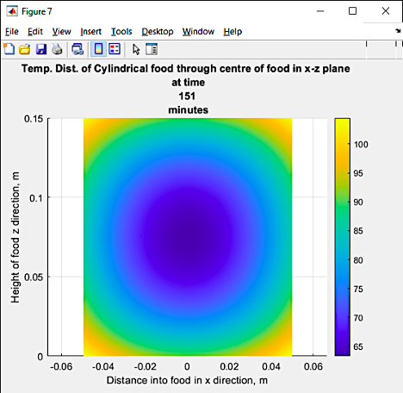
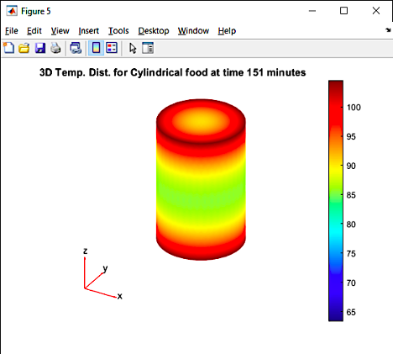
Results
Braising a cylindrical roll of meat
We find out that it work take 151 minutes for the minimum temperature within the pork to reach 65°C. 2hrs 31min is roughly how long you'd expect pork to braise for.

Slide 27
Results
Boiling a potato
Assumptions:
Spherical with radius 0.03m
Water is boiling at a constant temperature, 100°C, and surrounds the potato
Initial temperature is uniformly 10°C
Is considered cooked when centre reaches 95°C

Slide 28
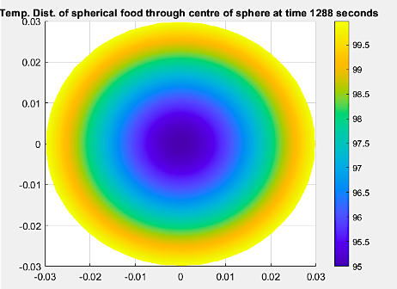
Results
Boiling a potato
The time taken for the potato to reach 95°C is 1288 seconds (21 minutes and 28 seconds), in line with instructions found online which says for 20 minutes.
As the boiling point is close to the desired temperature for a cooked potato, it is almost at thermal equilibrium.

Slide 29
Microwaving a Pizza
Results
Assumptions:​
assumes the microwaves hit the food in 2 dimensions, radially and in the same direction as the height.
Specific heat capacity is 1700 J kg⁻¹ K⁻¹
Pizza has mass of 0.16kg

Slide 30
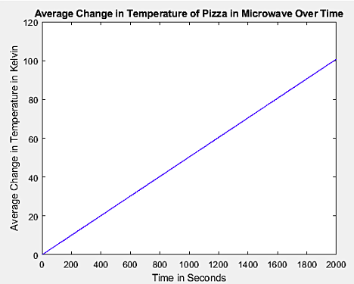
Microwaving a Pizza
Results
We require the pizza to go from a temperature of -18°C to 74°C, which is a total increase of 92°C, using the formula we found previously, it would require approximately 1827 seconds, which is 30 minutes and 27 seconds.
Instructed Cooking time was 3 minutes.
This inaccuracy can be explained as we did not have access to accurate dielectric and thermal property information of pizza.

Slide 31
Conclusion
5
Here we will talk about what how well our model had done and what further improvements we couldve made

Slide 32
Conclusion
Have we met the set out goals?
Our model delivers all the desired goals we had set out for it to do, with it being able to find the optimal amount of time for cooking for a variety of shapes as well as producing a visual aid that allows us to see how the temperature is distributed throughout the food.

Slide 33

Conclusion
Further improvements
Considering the effect of the conduction from the tray in the oven
Including the quality of cooking by applying the Maillard reaction to our models
Use of Maxwell’s equations with microwave heating
Introduce a variable thermal conductivity into our model
Investigating Robin Conditions
$k_{avg}= \frac{\int_{T_{1}}^{T_{2}}{k\left(T\right)dT}}{T_{2}−T_{1}}$

Slide 34
Thank you for Listening
Any questions?

Slide 35
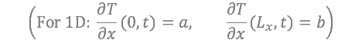
Modelling methods
Heat diffusion boundary conditions
For the Heat diffusion equation there are 3 types of boundary conditions
Dirichlet: temperature is specified at the boundaries.
Neumann: rate of temperature change specified at the boundaries.
Robin: a combination of Dirichlet and Neumann conditions.
Notes:
Say what Lx,Ly mean

Slide 36
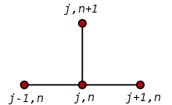
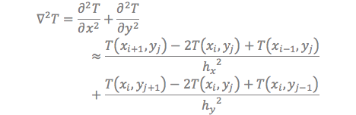
Modelling methods
Finite Difference
To produce a model given boundary conditions, we have decided to use numerical methods, one of which is the finite difference method.
What this entails is forming a mesh grid at discrete points in space and using an approximation of the heat diffusion equation and see how each point interacts with each other.
For 2D the approximations are:
Notes:
Describe what T(xi+1,yj) and T^k(xi,yj) mean (notation) etc

Slide 37
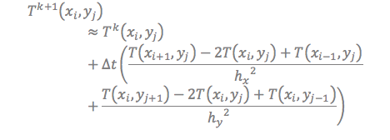
Modelling methods
Dirichlet boundary conditions (2D)
The ways we use the finite difference method change depending on the boundary condition due to it requiring values at either side of a point which the boundary doesn’t have.
With Dirichlet conditions, we can just impose the surface to always be our desired temperature so the boundary wouldn’t require any calculation, as it’ll be 200°C.
This allows us to find the next temperature with respect to time with this equation.

Slide 38


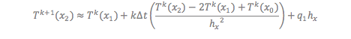
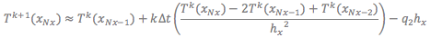
Modelling methods
Neumann boundary conditions (1D)
For this case we can have the Neumann boundary condition to be
Using this and the approximation that
We can gather the following
After substituting the above equations into the final equation we got on the previous slide we can obtain equations for the end nodes.

